Slide 1
What is an Alternatively powered Vehicle?
Definition:
A vehicle that runs on a fuel other than traditional gasoline or diesel; any method of powering an engine that does not involve petroleum.

Slide 2
Why Have Alternatively Powered Vehicles?
Environmental:
  Environment continues to be polluted, smog increases….
Dwindling Resources & Economics:
  Oil is becoming limited and expensive.
Political:
  Increasing international pressure to clean up the environment.

Slide 3
Advantages
&
Disadvantages of
Alternate Fuels

Slide 4

Hybrid Cars

Slide 5
What is a hybrid?
Hybrid electric vehicles (HEVs) include both a combustion engine as well as an electric motor.
    Mix between gasoline-powered car and an electric car (most common)

Slide 6
Why hybrids?
The best hybrids have made fuel economy gains of 30-80%
Emissions are greatly decreased. Average of 30 to 50% lower
Dependency on fossils fuels can be decreased.

Slide 7
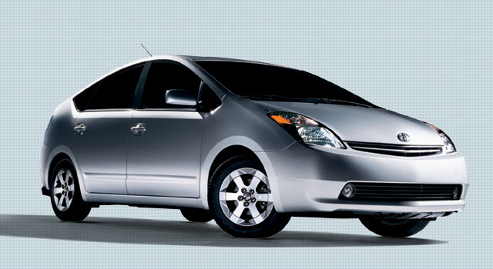
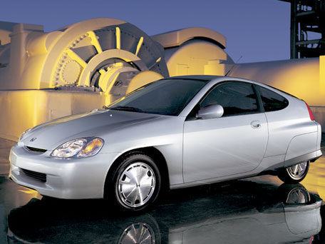
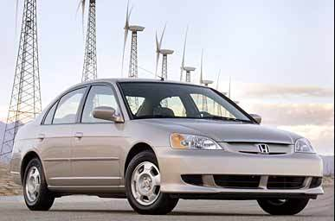
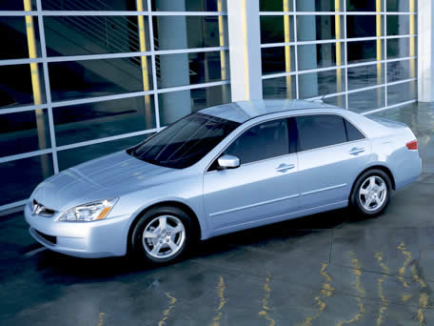
HYBRID ELECTRIC VEHICLES
Estimated Highway Fuel Economy
U.S. conventional Honda Insight
4 cylinder car 68 mpg
Toyota Prius
25 mpg 51 mpg
Honda Civic
Hybrid
50 mpg
U.S. conventional Honda Accord
6 cylinder car Hybrid
20 mpg 37 mpg
Toyota Prius
Honda Insight
Honda Civic Hybrid
Honda Accord Hybrid

Slide 8
Cost
Initial purchase price is on average $5,000 to $10,000 more then a standard model.
But……
Petroleum based fuels are steadily getting more expensive.
Gov’t Tax Incentives:
    $2000 to $5000 tax break (depending upon area) if you buy a hybrid.

Slide 9
Better But Not Best
If we had better batteries, we would not need hybrids at all. Electric vehicles are zero emissions.
Hybrids are not zero-emission vehicles. (gas engine)
Will cut down emissions of global-warming pollutants by a third to a half.

Slide 10
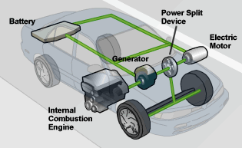
Main Components

Slide 11
How they Work
Low speeds= Electric motor only
Medium speed= Gas engine runs, and charges batteries, supplements electric motor
High speed= both Battery and gas engine run
Braking/Slowing down= Gas engine shuts off, kinetic energy from brakes drive generator and charges batteries

Slide 12
How They Work?
Toyota Hybrid System 2

